Slide 1

Event sourcing & DDD
Gabriel Schenker, Clear Measure

Slide 2


CQRS
Command Query Responsibility Segregation
Commands cause side effects in the system
Queries are side effect free

Slide 3

CQRS
Command
Query
CHANGE
Persist change
Data Store

Slide 4


ES
Event Sourcing
Events tell what has happened
Cannot be undone
Name → Context
Payload → what changed
Events are persisted NOT state!

Slide 5
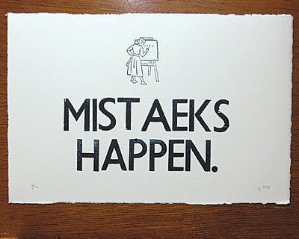
What about mistakes?
Events are immutable
Events cannot be deleted
Mistakes need to be compensated
“I’m going to the butcher and ask for 5 pounds of brisket. The butcher cuts a large piece and puts in on the scale. The scale shows 7 pounds. That is too much for me thus the butcher has to trim the piece until it is approximately 5 pounds.”

Slide 6

Ubiquitous language
Business domain is core
Domain is about change
Aggregates
Actions

Slide 7

It’s time for coding…
Define a REST API
Application service
Aggregate
Adding the Event Store
The Read Model

